Slide 1
Getting Started with GitHub
Authored By: John Thibert
Latest Revision: 05/01/2025

Slide 2
Revision Table
Date (MM/DD/YYYY) | Description
05/01/2025 | First Release

Slide 3
What is GitHub?
A collaborative platform for software development and project management
Hosts repositories (repos) to store, track, and share project files and code
Cloud based storage for all file types
Based on the “Git” system

Slide 4
What is the purpose of GitHub?
Version control: Tracks changes and allows rollback to earlier versions
Collaboration: Enables multiple people to work together on projects simultaneously
Task management: Organizes project tasks using built-in project boards
Documentation: Maintain sustainability and knowledge transfer by showing the paths and details of the design/programming process
File Storage: Allows us to store files on the cloud for use in future years

Slide 5
Why is it important? What do we use it for?
Programming:
Stores the code for the robot
Allows people to work on stuff at the same time
Make modifications or test functionalities while maintaining the previous versions
Organizes changes and notifies people of what has changed and where
Mechanical:
Stores robot CAD files
Allows everyone to have access to the latest CAD
Allows people to make changes and concepts to be reviewed before executing on the main robot
Organizes tasks and issues associated with various subsystems
Documents our design process for later use (judges and awards)

Slide 6
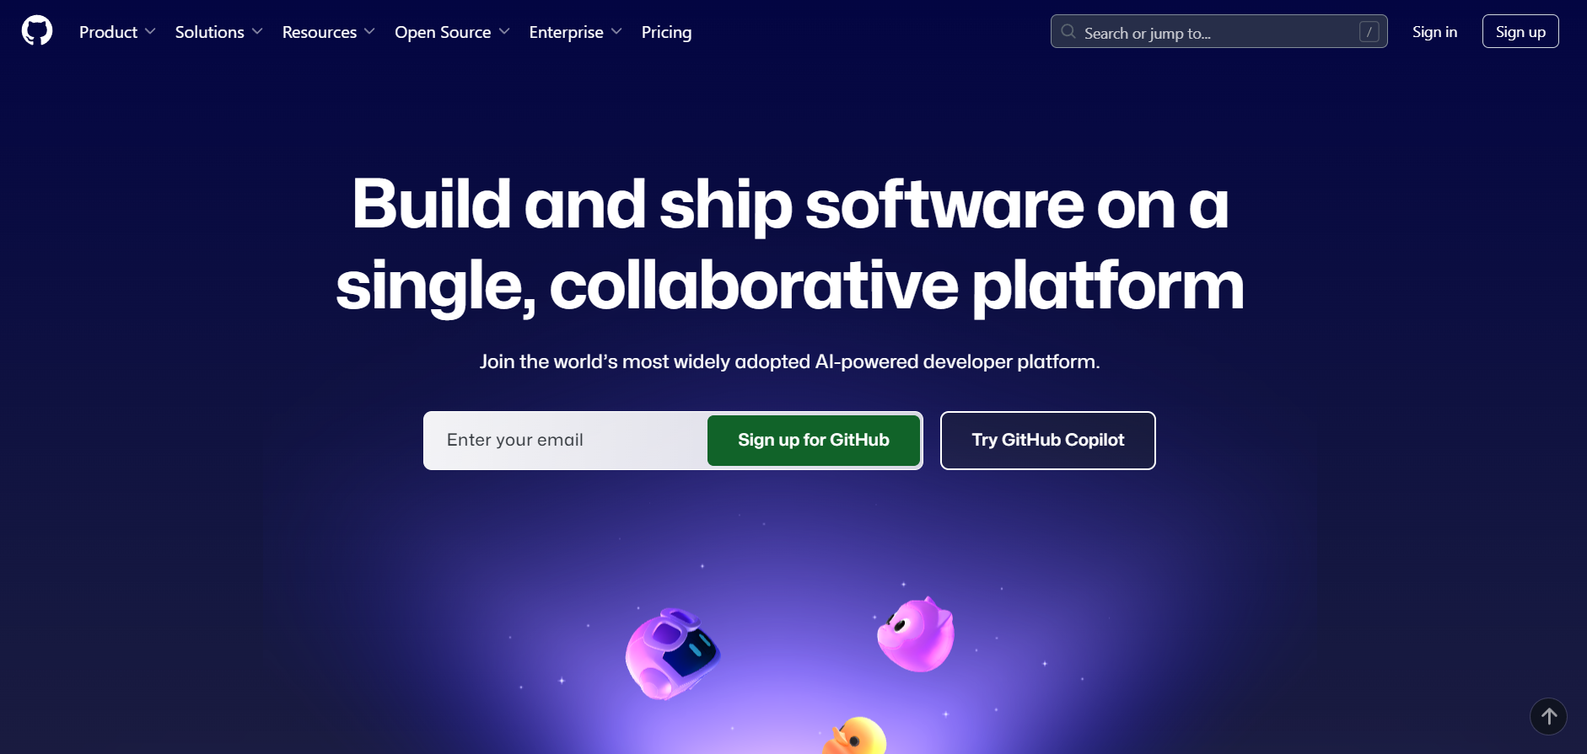
Creating a GitHub account:
Use an appropriate name for your profile, having your GitHub public to show what you’ve worked on is a fantastic resume for employers!!

Slide 7
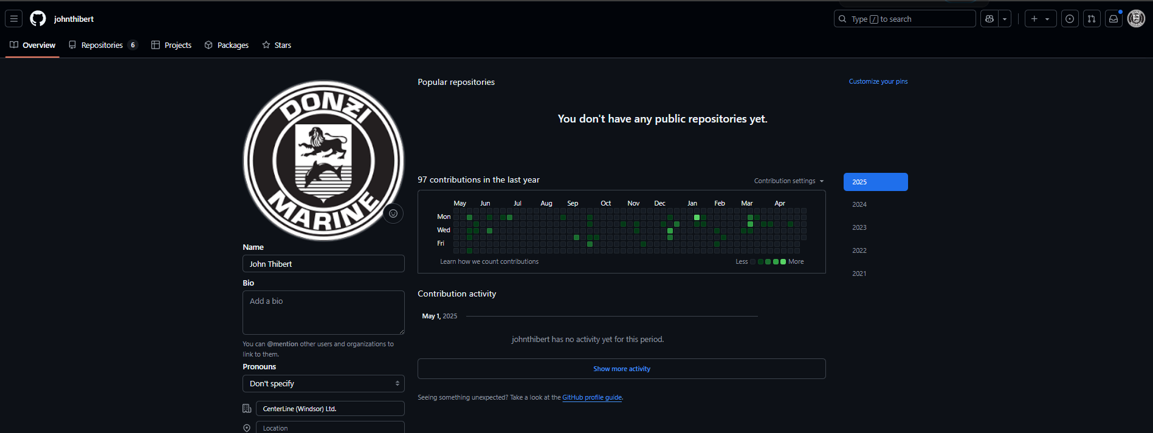
Creating a GitHub account:
Put your real name here

Slide 8
Creating a GitHub account:
Once you have created an account, contact a mentor to invite you to the FRC5885 GitHub page:
https://github.com/frc5885
This will allow you to make changes and view archived and private repositories

Slide 9
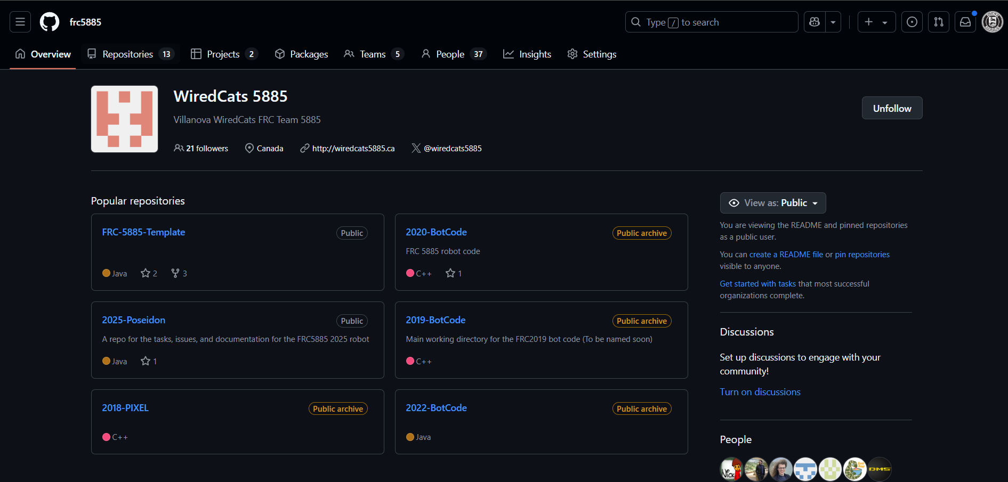
FRC5885 homepage
Repo’s and projects can be found under these tabs of the FRC5885 homepage. Projects will be the most frequently accessed.

Slide 10
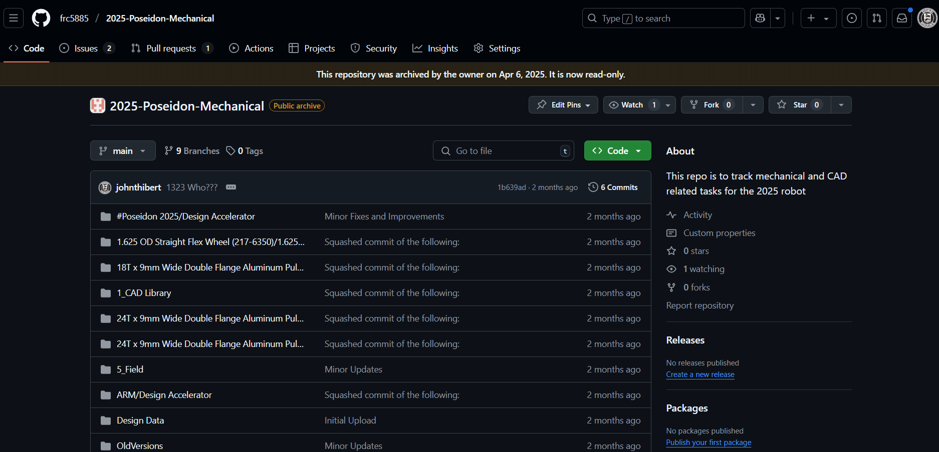
Intro to GitHub - Repositories
Poseidon mechanical repository
Branch selection
Issues/tasks related to this repo
CAD Files

Slide 11
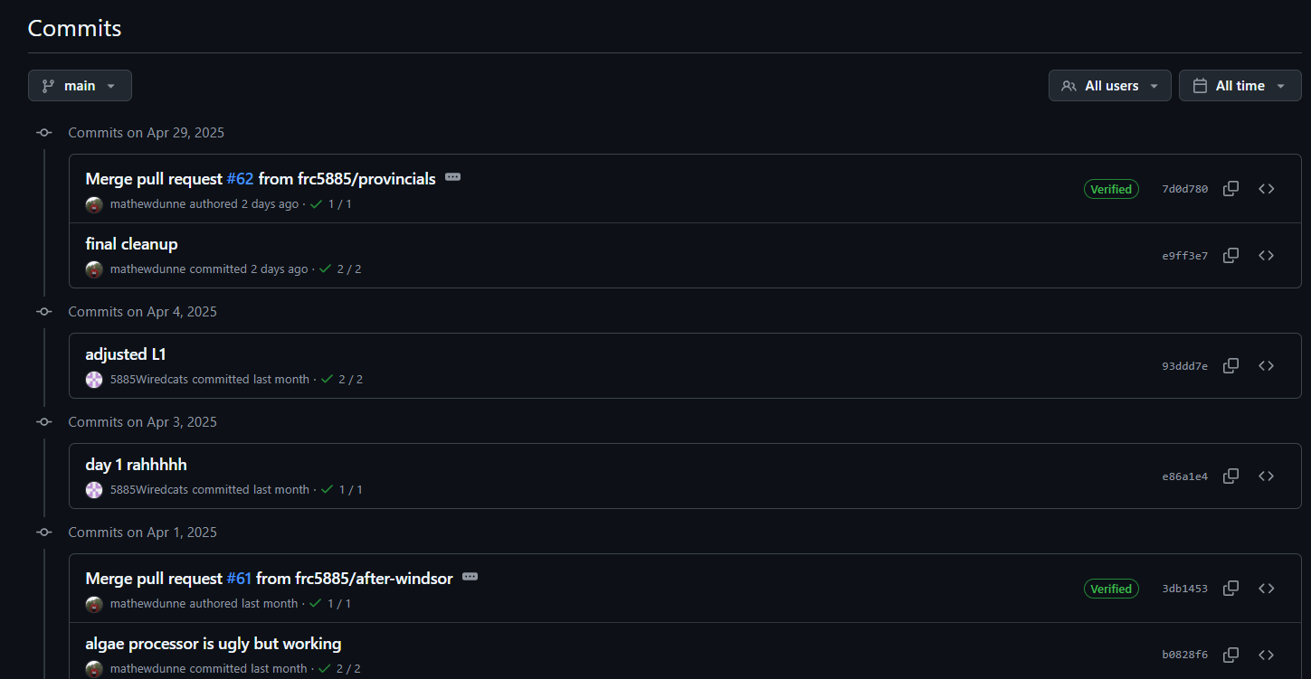
Intro to GitHub - Commits
Commits are “check-ins”
When you are working on a branch of code and want to save it to the repository (saving progress, completed a task, fixed an issue, added a feature) you use a commit to save that progress.
Captures your work at that time

Slide 12
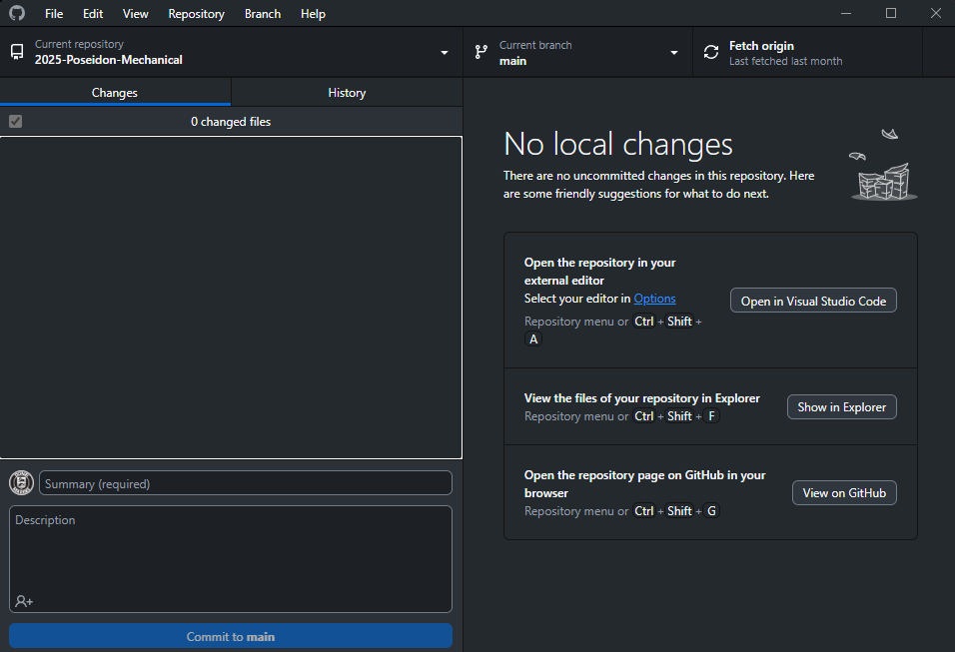
Intro to GitHub - Pushes
Repository selection
Branch selection
Whenever a commit is made, that change is solely local.
When you want to upload that commit to GitHub, you do so with a “push”.
Pushes upload all your “stashed” commits to the branch you are working on
Changes to files will show up here
Shown above is the “GitHub Desktop” application interface – more on this later

Slide 13
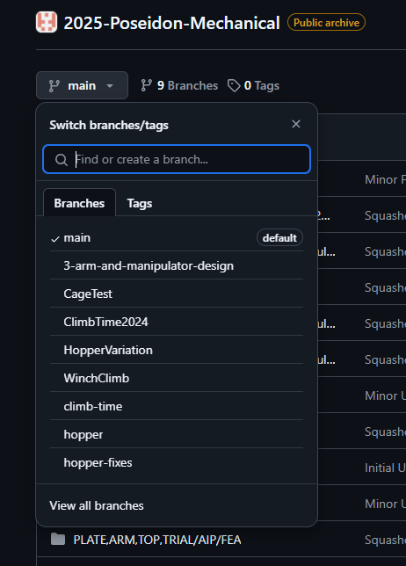
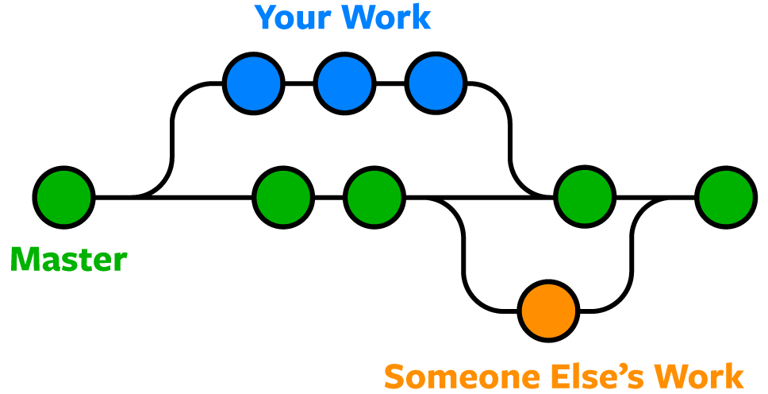
Intro to GitHub - Branches
When you are done your changes, they get “merged” back into the main branch
This is a branch you create to make your changes
Also called “main”
Each bubble is a commit

Slide 14
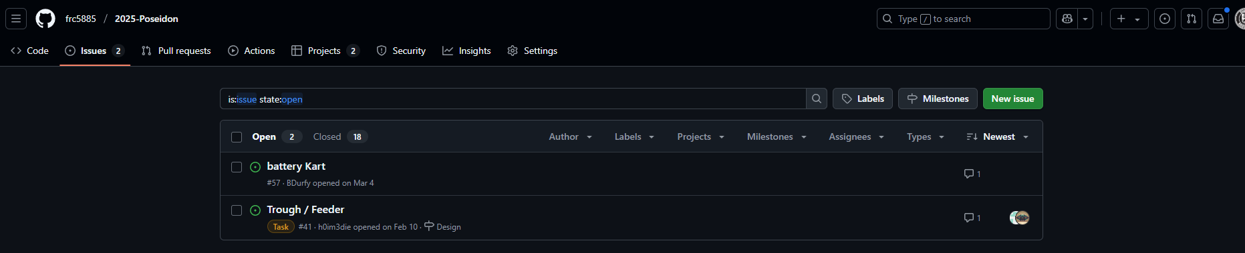
Intro to GitHub - Issues
Current “closed” issues
Current “open” issues

Slide 15
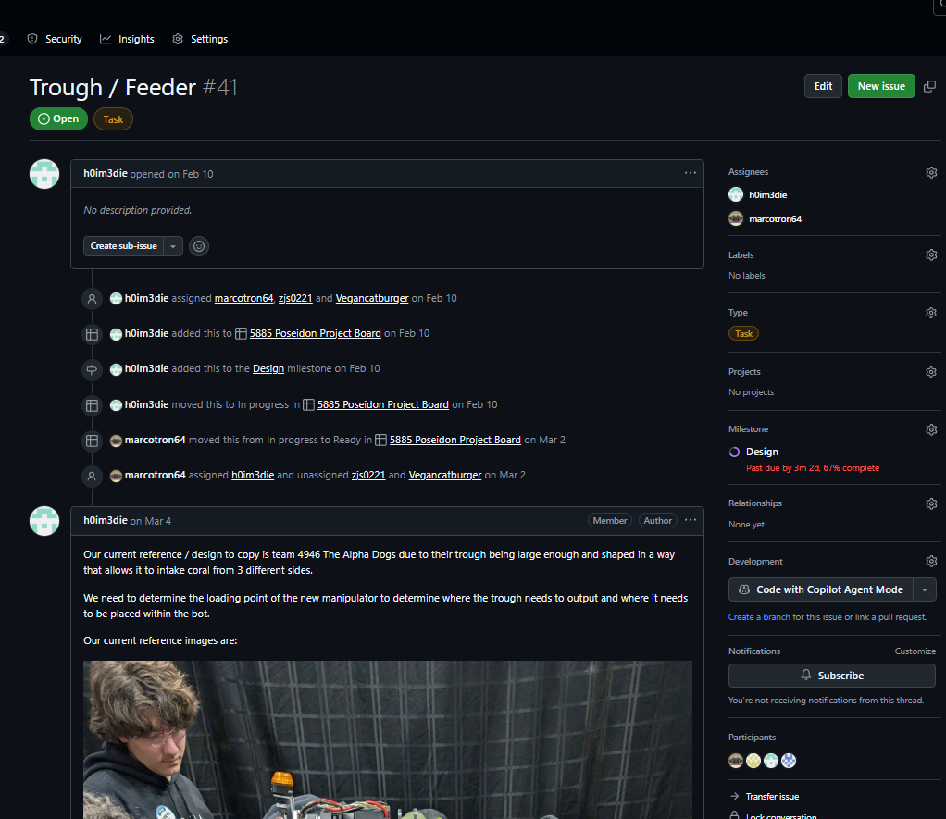
Intro to GitHub - Issues
Issue is currently an “open” issue
Issues always need to be made to a repository
Issues always need to be given a milestone and added to the project board
Tracks history of the issue and status
An update Owen provided when looking at 4946’s feeder mechanism

Slide 16
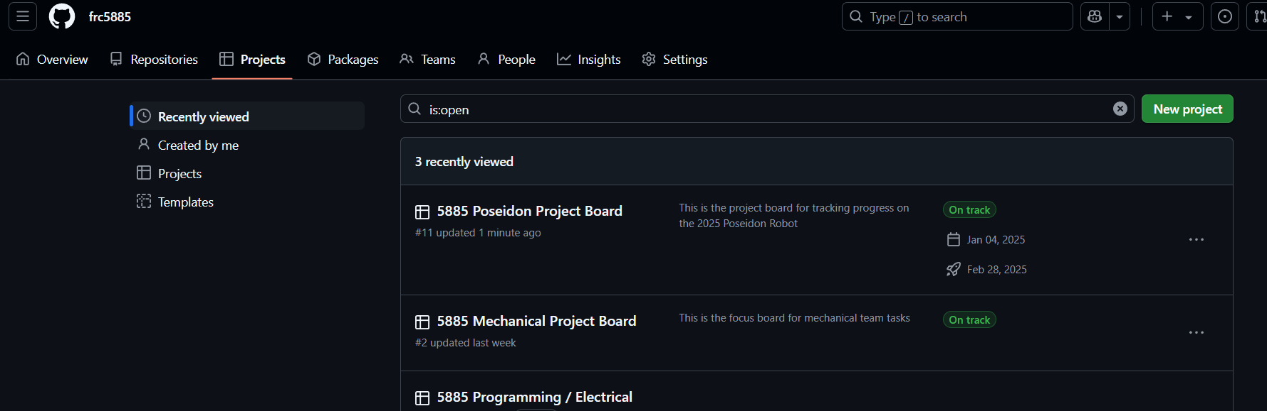
Intro to GitHub - Projects
Projects allow us to organize issues, tasks, and deadlines all in one place
Projects typically get created for large scale projects such as the 2025 robot

Slide 17
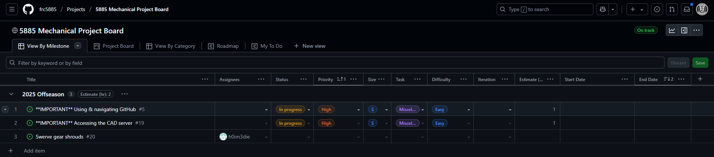
Intro to GitHub – Project Boards
Project boards allow us to see all the current issues and tasks associated with that project
The mechanical project board organizes this information to make sure important tasks are highly visible and tracks progress of them

Slide 18
See next presentation on GitHub workflow

